Slide 1
FACE EXPRESSION RECOGNITION USING KERAS
Name: NAGA SHARAVANESH S
Register number: 813821104064
Department: Computer science and engineering
Email ID:sharavanesh1212@gmail.com

Slide 2
Face Expression Eecognition
Face expression recognition is a rapidly evolving field in Artificial Intelligence (AI) that aims to identify and classify human emotions from various data sources.
Facial Expression Recognition: Analyzes facial features like wrinkles, eyebrows, and lip movements to infer emotions. Convolutional Neural Networks (CNNs) are commonly used to extract features, while Recurrent Neural Networks (RNNs) can handle the temporal nature of facial expressions.
Applications:
Human-Computer Interaction (HCI)
Customer Service
Market Research
Mental Health Monitoring

Slide 3


AGENDA
PROBLEM STATEMENT
PROJECT OVERVIEW
END USERS
SOLUTIONS
NEW ADD-ONS
MODELLING
RESULTS
3/21/2024 Annual Review

Slide 4

PROBLEM STATEMENT
Face expression recognition using Deep Learning
The goal is to create a emotion dectection using the emotion of human face.
Emotion is a psycho physiological process that directly related to brain activities . with the face expression recognition model we can interpreter the emotion.
The system should work on embedded platform.
Human can understand emotion more than the text but it will be difficult for a machine to understand.
Phycologist mostly work with the human emotion with a machine algorithm they can easily work.

Slide 5

PROJECT OVERVIEW
Develop robust algorithms for face expression recognition from diverse data sources, including text, speech, facial expressions, and physiological signals.
Implement multimodal fusion techniques to integrate information from different modalities and enhance face expression recognition accuracy.
Create a user-friendly interface for real-time face expression recognition and visualization of results.
Evaluate the performance of the face expression recognition system using benchmark datasets and real-world applications.

Slide 6

WHO ARE THE END USERS ?
Educators and Students: In educational settings, educators and students could benefit from face expression recognition systems that gauge student engagement and emotional .
Customer Service Representatives: In customer service applications, end users could be customer service representatives who use face expression recognition tools to analyze customer sentiment during interactions and tailor their responses accordingly.
Law Enforcement and Security Personnel: Law enforcement and security personnel may utilize face expression recognition systems for monitoring public safety and security, detecting potential threats or suspicious behavior based on facial expressions and behavioral cues.
Marketing Professionals: Marketing professionals could use face expression recognition systems to analyze consumer responses to advertisements, social media campaigns, and product launches, helping them understand customer.
Healthcare Providers: Healthcare providers may use face expression recognition technology to assess patients' emotional states and monitor mental health conditions, enabling early intervention and personalized treatment plans.
Human-Computer Interaction Designers: Human-computer interaction designers could use face expression recognition systems to create more intuitive and responsive interface

Slide 7

YOUR SOLUTION AND ITS VALUE PROPOSTION
Component | Technology | Description
Frontend (Video Processing & UI) | OpenCV (cv2) | Open-source library for capturing video, face detection, drawing on frames.
Backend (Model Processing) | TensorFlow (assumed) | Deep learning framework (potentially interchangeable with other Keras backends).
Data Manipulation | NumPy (numpy) | Library for numerical computations used for image preprocessing.
Programming Language | Python | General-purpose language for scripting and scientific computing.
Insights and Decision Support: EmotionSense provides valuable insights into customer sentiment, mental health status, user engagement.
Multimodal face expression recognition: EmotionSense integrates information from multiple modalities, including text, speech, facial expressions.
User-friendly Interface: EmotionSense features an intuitive user interface that allows users to easily input data and visualize face expression recognition results in a clear and actionable format.

Slide 8

THE WOW IN YOUR SOLUTION
Holistic Understanding: Emotion Sense doesn't just analyze text or interpret facial expressions; it comprehensively captures emotions across multiple modalities, providing a holistic view of emotional states and responses.
Instantaneous Insights: By processing data in real-time, Emotion Sense delivers instantaneous insights into users' emotional states, enabling immediate action and response to dynamic situations.
Adaptive Intelligence: Emotion Sense adapts and learns from user interactions, continuously improving its accuracy and effectiveness in understanding and interpreting emotions over time.
Endless Possibilities: From enhancing customer experiences to revolutionizing mental health care, the applications of Emotion Sense are limitless, offering endless possibilities for innovation and impact across industries and domains.
3/21/2024 Annual Review

Slide 9
MODELLING
Convolutional Neural Networks (CNNs):
Extract features from facial images like wrinkles, eyebrows, and lip corners.
Common architectures include VGG16, ResNet50 with pre-trained weights for feature extraction and fine-tuned final layers for emotion classification.
Webcam-based face expression recognition (Desktop Application):
Main Screen:
Webcam feed displaying the user's face.
Real-time face expression recognition results overlaid on the video (e.g., text labels or emoticons).

Slide 10
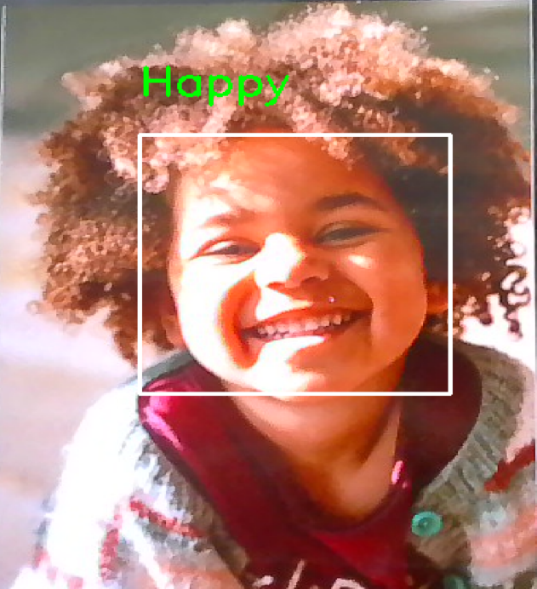
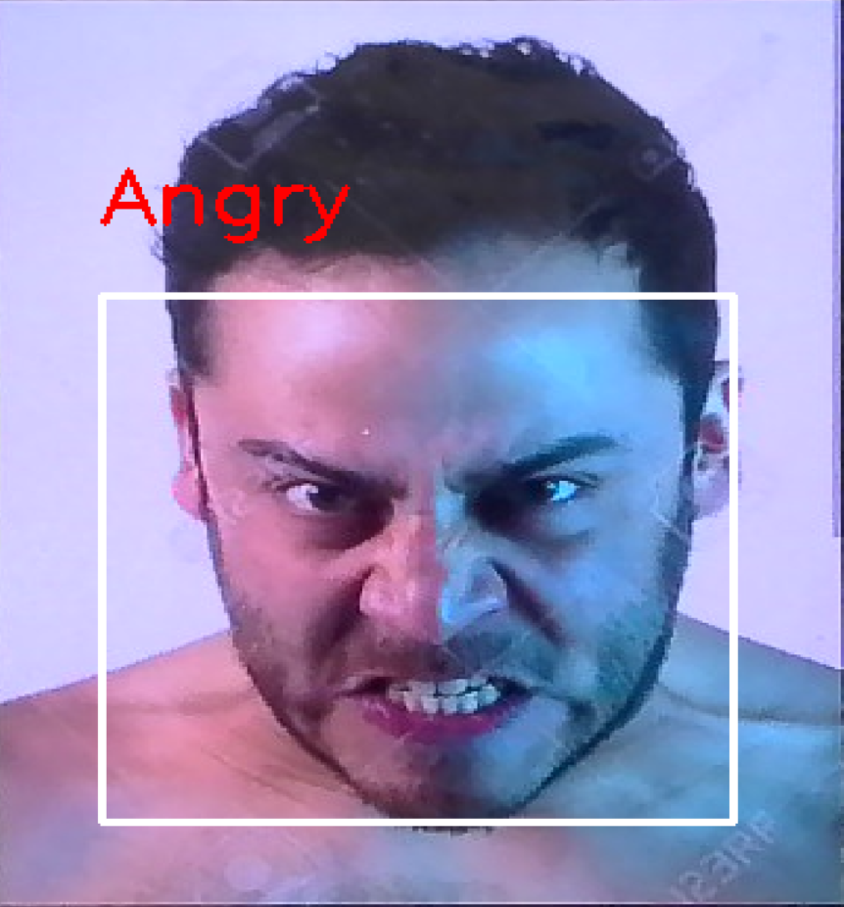
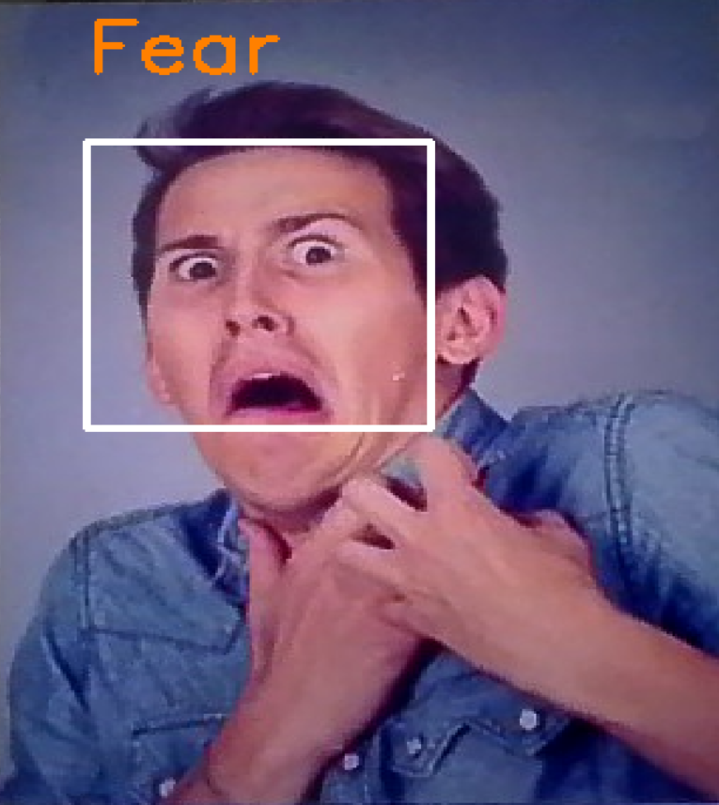
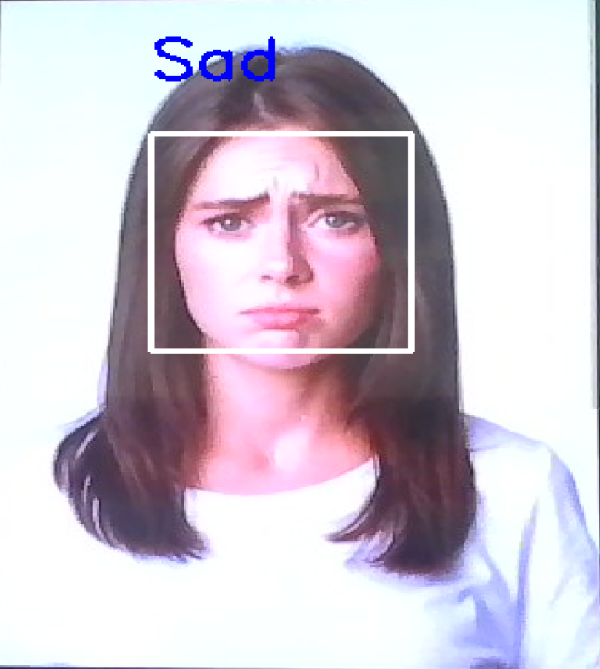
RESULTS
Here are the screenshots of FER
https://github.com/Sharavanesh10/TNSDCGenAI.git

